Slide 1
Squaring numbers and more
This program grew TO DO MORE THAN I ANTICIPATED

Slide 2
PURPOSE
This program was originally meant to insert numbers, multiply them by themselves but the program expanded to be able to perform other functions such as
Square roots
Logarithms
Addition
Sine

Slide 3
OVERVIEW
A web app is a software application that can run in a web browser.
Web apps can be games, calculators or anything as long as it is connected to a web browser.

Slide 4
FRAMEWORK
The program is named squared as it’s original purpose was simply to multiply inserted numbers by themselves and to keep track of the results.

Slide 5
DESCRIPTION
The program can now do much more than simply squaring numbers. It can find square roots, add numbers together, find the log10 of the number and find the sin value associated with the number.

Slide 6
Languages
There are so many great languages.
English, French, Italian, Spanish, German etc.
But there are also programming languages, c+, java, etc.
I used the program Microsoft Visual Basic
Microsoft Visual Basic is an object oriented language.

Slide 7
PROTOCOLS
I used protocols such as Math.sin(); Math.log();
If then protocols along with many other common protocols.

Slide 8
THE STACK
The technology stack is the grouping of both the program used to create the code and the program used to run the code.
The first layer is needed to use the programming language and make the code readable.
The second layer is used to read the code.

Slide 9
THE STACK’S LAYERS
Both the layers were Microsoft Visual Basic. The program is able to make code using java in one layer while it can run that code in a client side.
Microsoft Visual Basic is a middleware program as it can perform both the functions of the stack.

Slide 10
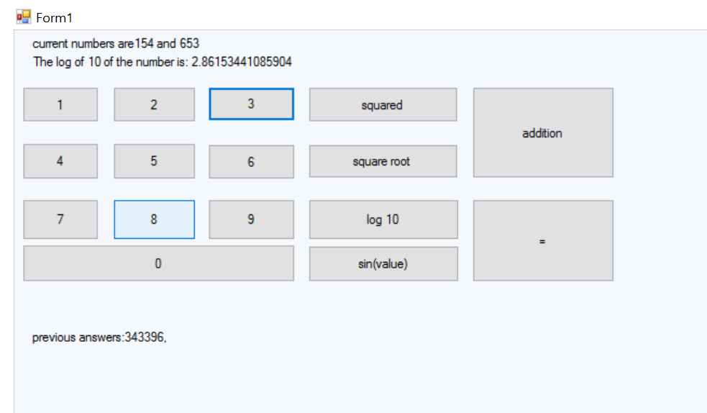
DEMO SCREENCAPS

